Slide 1
Cohort State-Transition Models (cSTMs)
Day 2

Slide 2
A Challenge for Public Policy
Complete course of public policies might never be directly observed.
Randomized controlled trials of every potential preventive and treatment policy is not feasible.
Even the best available data will rely on surrogate markers and intermediate endpoints.
The information required to develop policies will require synthesis of data from many sources.
Notes:
4

Slide 3
A Challenge for Public Health
Complete course of disease will never be directly observed.
Randomized controlled trials of every potential preventive and treatment approach is not feasible.
Even the best available data will rely on surrogate markers and intermediate endpoints.
The information required to develop policies will require synthesis of data from many sources.
Notes:
4

Slide 4
Elements of a Decision Analysis
Identify and bound the decision problem
Structure the elements of the problem into a logical framework over time (i.e., build a model)
Identify, retrieve, and characterize the information needed
Conduct a base case analysis
Evaluate uncertainty
Notes:
4

Slide 5
Problems
Critical details make the decision problem complex
Events occur at different times and repeatedly
Risk of infection decreases with time, risk of negative consequences increase with time
Fixed time horizon does not consider long term consequences, such as life expectancy and quality-adjusted life expectancy
Limited ability to evaluate a broader set of questions or to consider alternative strategies
Notes:
4

Slide 6
Markov models are most useful when….
decision problem involves risk over time
timing of events is important
  early risk, late benefit
events may happen more than once
states change over time
  progression from mild to severe status
Notes:
4

Slide 7
Time-homogeneous

Slide 8
Markov Property: Markovian Assumption
Specifies that the behavior of the process subsequent to any cycle depends only on its description in that cycle. The process has no memory for earlier cycles.
A separate state must be created for each subset of the cohort that has a prognosis (or utility or cost).
Notes:
4

Slide 9
Markov Process
Modeling technique, derived from matrix algebra, that helps get around some of the “limitations” of a simple decision tree with a fixed time horizon
Notes:
4

Slide 10
Implicit Assumptions
States are mutually exclusive
States are collectively exhaustive
Memorylessness
Notes:
4

Slide 11
Building a Markov Model
Determine health states
Determine transitions
Choose cycle length
Estimate transition probabilities
Estimate state utilities and costs per cycle
Calculate
(Sensitivity analysis)
Notes:
4

Slide 12
Markov Health States
Healthy (H)
Sick (S)
Dead (D)
Notes:
4

Slide 13
Building a Markov Model
Determine health states
Determine transitions
Choose cycle length
Estimate transition probabilities
Estimate state utilities and costs per cycle
Calculate
(Sensitivity analysis)
Notes:
4

Slide 14
State Transition Diagram (STD)
Healthy (H)
Sick (S)
Dead (D)
Notes:
4

Slide 15
Building a Markov Model
Determine health states
Determine transitions
Choose cycle length
Estimate transition probabilities
Estimate state utilities and costs per cycle
Calculate
(Sensitivity analysis)
Notes:
4

Slide 16
Cycle
A brief time interval during which individuals within a cohort may make a transition into another health state or remain in the current health state.
Notes:
4

Slide 17
Building a Markov Model
Determine health states
Determine transitions
Choose cycle length
Estimate transition probabilities
Estimate state utilities and costs per cycle
Calculate
(Sensitivity analysis)
Notes:
4

Slide 18
Transition Probability
The chance that patients in a particular state will transition to another state during the course of a cycle.
Notes:
4

Slide 19
Transition Probability
The chance that patients in a particular health state will transition to another health state during the course of a cycle.
Notes:
4

Slide 20
State Transition Diagram (STD) p_ij= transition probability from state i to state j
p_HS
Healthy (H)
Sick (S)
p_HD
p_SD
Dead (D)
Notes:
4

Slide 21
Building a Markov Model
Determine health states
Determine transitions
Choose cycle length
Estimate transition probabilities
Estimate state utilities and costs per cycle
Calculate
(Sensitivity analysis)
Notes:
4

Slide 22
Quality-of-Life Adjustment
1.0
0.5
0.0
Healthy
Sick
Dead
Notes:
4

Slide 23
Building a Markov Model
Determine health states
Determine transitions
Choose cycle length
Estimate transition probabilities
Estimate state utilities and costs per cycle
Calculate
(Sensitivity analysis)
Notes:
4

Slide 24
Methods of Evaluation
Closed-form fundamental matrix solution
Cohort simulation
  hypothetical cohort of patients transition through the model simultaneously
Monte Carlo simulation
  first order simulation randomly selects an individual from the hypothetical cohort and they transition through the model one at a time
Notes:
4

Slide 25
Methods of Evaluation
Closed-form fundamental matrix solution
Cohort simulation
  hypothetical cohort of patients transition through the model simultaneously
Monte Carlo simulation
  first order simulation randomly selects an individual from the hypothetical cohort and they transition through the model one at a time
Notes:
4

Slide 26
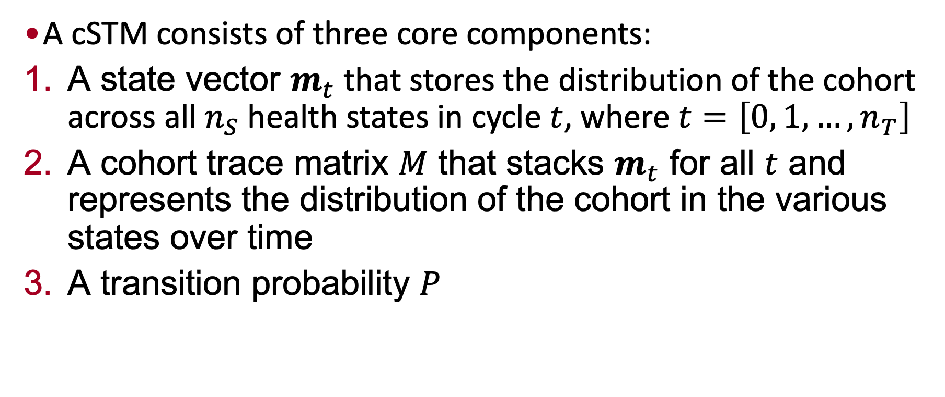
Cohort Simulation
A cSTM consists of three core components:
A state vector $m_{t}$ that stores the distribution of the cohort across all $n_{S}$ health states in cycle $t$, where $t=\left[0, 1, …,n_{T}\right]$
A cohort trace matrix $M$ that stacks $m_{t}$ for all $t$ and represents the distribution of the cohort in the various states over time
A transition probability $P$
Notes:
4

Slide 27

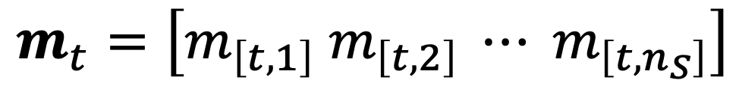

State vector ($m_{t}$with $n_{S}$ health states):
Each $i$-th element of $m_{t}$ represents the distribution of the $i$-th health state in cycle $t$, referred to as $m_{[t,i]}$
$$m_{t}=\left[m_{\left[t,1\right]} m_{\left[t,2\right]} ⋯ m_{\left[t,n_{S}\right]}\right]$$
Notes:
4

Slide 28

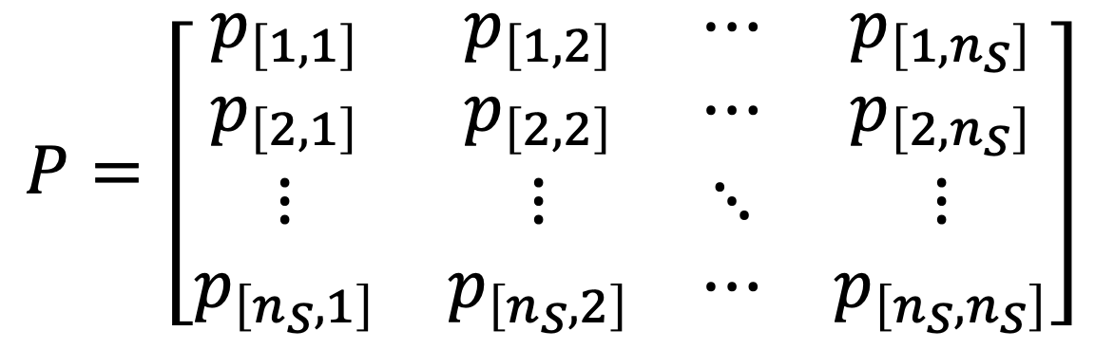
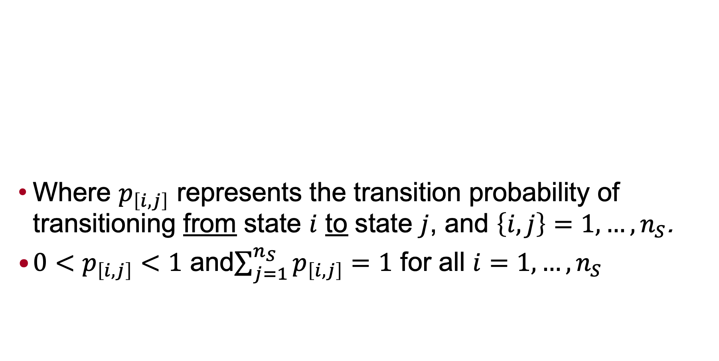
Transition Matrix ($n_{S}$ health states):
Where $p_{\left[i,j\right]}$ represents the transition probability of transitioning from state $i$ to state $j$, and $\left\{i,j\right\}=1,…,n_{S}$.
$0<p_{\left[i,j\right]}<1$ and$\sum_{j=1}^{n_{S}}{p_{\left[i,j\right]}}=1$ for all $i=1,…,n_{S}$
$$P=\left[\begin{matrix}p_{\left[1,1\right]} & p_{\left[1,2\right]} & ⋯ & p_{\left[1,n_{S}\right]} \\ p_{\left[2,1\right]} & p_{\left[2,2\right]} & ⋯ & p_{\left[2,n_{S}\right]} \\ ⋮ & ⋮ & ⋱ & ⋮ \\ p_{\left[n_{S},1\right]} & p_{\left[n_{S},2\right]} & ⋯ & p_{\left[n_{S},n_{S}\right]}\end{matrix}\right]$$
Notes:
4

Slide 29
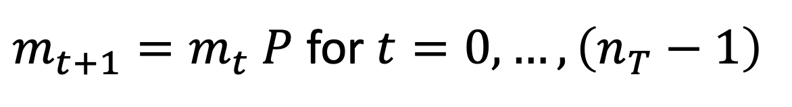
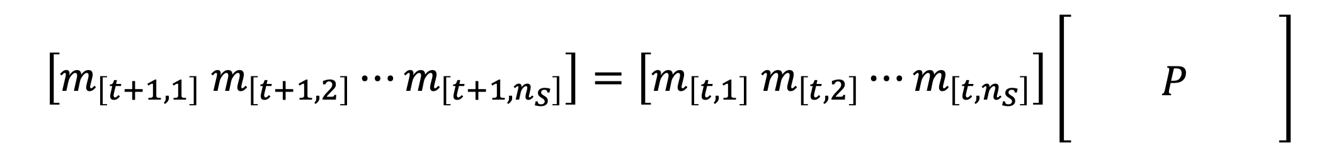
Cohort at next cycle using matrix multiplication
Cohort distribution at next time step calculated through matrix multiplication
$m_{t+1}=m_{t} P$ for $t=0, …,\left(n_{T}−1\right)$
$$\left[m_{\left[t+1,1\right]} m_{\left[t+1,2\right]}⋯m_{\left[t+1,n_{S}\right]}\right]=\left[m_{\left[t,1\right]} m_{\left[t,2\right]}⋯m_{\left[t,n_{S}\right]}\right]\left[\begin{matrix} & & \\ & P & \\ & & \end{matrix}\right]$$
Notes:
4

Slide 30



Cohort trace $M$
The cohort trace matrix, $M$, is a matrix of dimensions $\left(n_{T}+1\right)×n_{S}$, where each row is a state vector $\left(−m_{t}−\right)$
$$M=\left[\begin{matrix}−m_{0}− \\ −m_{1}− \\ ⋮ \\ −m_{n_{T}}−\end{matrix}\right]$$
Notes:
4

Slide 31
Three-State Markov Model
Time
t
Healthy
Sick
Dead
p_HD
p_SD
1
p_HH
p_HS
p_SS
Healthy
Sick
Dead
t+1

Slide 32
Types of Markov Models
Absorbing models (e.g., includes death)
  Goal: Calculate residence times in transient states
  means (e.g., life expectancy)
  weighted means (e.g., QALE, discounted LE)
Non-absorbing models (e.g., nonfatal states)
  Goal: Calculate long-run proportions of time spent in each state
  equilibrium distribution across states
Notes:
4

Slide 33
Outputs of Absorbing Models
Life expectancy: average number of cycles in “live” states
Weighted life expectancy: average number of cycles in “live” states, each weighted by a state utility or cost
Discounted life expectancy: average number of cycles in “live” states, each cycle weighted by (1+r)^{-t}
Notes:
4

Slide 34
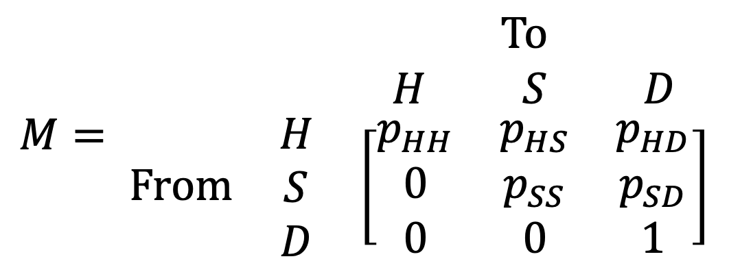
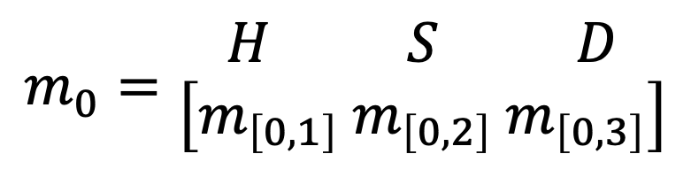
Back to the Simple Example
Transition Matrix
$$M= \begin{matrix} \begin{matrix} \text{To} \\ \begin{matrix} H & S & D\end{matrix}\end{matrix} \\ \begin{matrix}\begin{matrix}\text{F}\text{rom} & \begin{matrix}H \\ S \\ D\end{matrix}\end{matrix} & \left[\begin{matrix}p_{HH} & p_{HS} & p_{HD} \\ 0 & p_{SS} & p_{SD} \\ 0 & 0 & 1\end{matrix}\right]\end{matrix}\end{matrix}$$
Initial State Vector
$$m_{0}=\begin{matrix}\begin{matrix}H & S & D\end{matrix} \\ \left[m_{\left[0,1\right]} m_{\left[0,2\right]} m_{\left[0,3\right]}\right]\end{matrix}$$

Slide 35
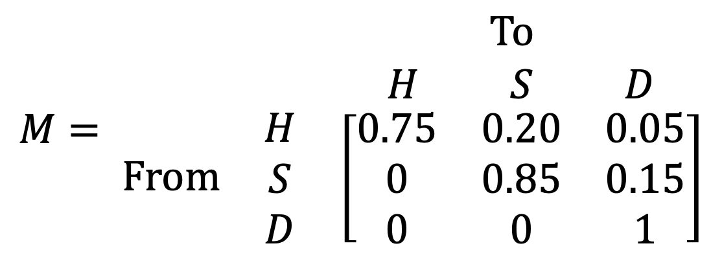
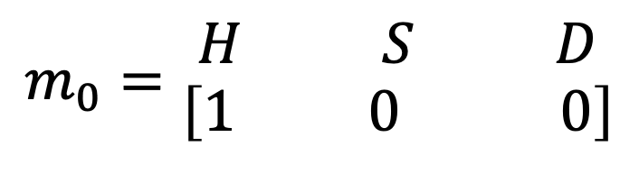
Back to the Simple Example
Transition Matrix
$$M= \begin{matrix} \begin{matrix} \text{To} \\ \begin{matrix} H & S & D\end{matrix}\end{matrix} \\ \begin{matrix}\begin{matrix}\text{F}\text{rom} & \begin{matrix}H \\ S \\ D\end{matrix}\end{matrix} & \left[\begin{matrix}0.75 & 0.20 & 0.05 \\ 0 & 0.85 & 0.15 \\ 0 & 0 & 1\end{matrix}\right]\end{matrix}\end{matrix}$$
Initial State Vector
$$m_{0}=\begin{matrix}\begin{matrix}H & S & D\end{matrix} \\ \left[1 0 0\right]\end{matrix}$$

Slide 36

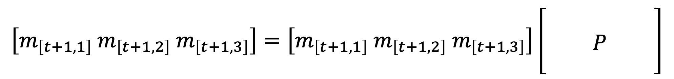
Cohort at next cycle using matrix multiplication
Cohort distribution at next time step calculated through matrix multiplication
$$m_{t+1}=m_{t} P$$
$$\left[m_{\left[t+1,1\right]} m_{\left[t+1,2\right]} m_{\left[t+1,3\right]}\right]=\left[m_{\left[t+1,1\right]} m_{\left[t+1,2\right]} m_{\left[t+1,3\right]}\right]\left[\begin{matrix} & & \\ & P & \\ & & \end{matrix}\right]$$
Notes:
4

Slide 37
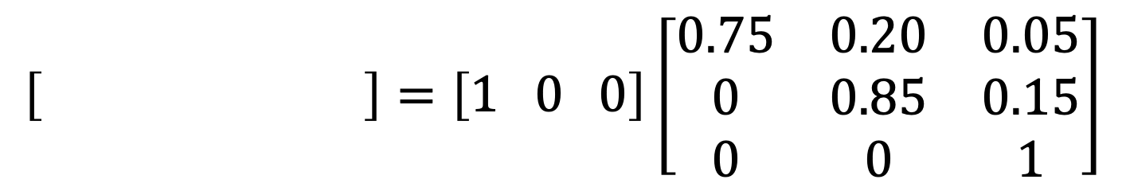
Cohort at next cycle using matrix multiplication
Cohort distribution at next time step calculated through matrix multiplication
$$\left[0.75 0.20 0.05\right]=\left[1 0 0\right]\left[\begin{matrix}0.75 & 0.20 & 0.05 \\ 0 & 0.85 & 0.15 \\ 0 & 0 & 1\end{matrix}\right]$$
Notes:
4

Slide 38
Cohort at next cycle using matrix multiplication
Cohort distribution at next time step calculated through matrix multiplication
$$\left[0.75 0.20 0.05\right]=\left[1 0 0\right]\left[\begin{matrix}0.75 & 0.20 & 0.05 \\ 0 & 0.85 & 0.15 \\ 0 & 0 & 1\end{matrix}\right]$$
$$\text{P}\text{(}\text{H} \text{at} t=1\text{)=(1)(0.75)+(0)(0)+(0)(0) = 0.75}$$
Notes:
4

Slide 39

Cohort at next cycle using matrix multiplication
Cohort distribution at next time step calculated through matrix multiplication
$$\left[0.75 0.20 0.05\right]=\left[1 0 0\right]\left[\begin{matrix}0.75 & 0.20 & 0.05 \\ 0 & 0.85 & 0.15 \\ 0 & 0 & 1\end{matrix}\right]$$
$$\text{P}\text{(}\text{H} \text{at} t=1\text{)=(1)(0.75)+(0)(0)+(0)(0) = 0.75}$$
Notes:
4

Slide 40
Cohort at next cycle using matrix multiplication
Cohort distribution at next time step calculated through matrix multiplication
$$\left[0.75 0.20 0.05\right]=\left[1 0 0\right]\left[\begin{matrix}0.75 & 0.20 & 0.05 \\ 0 & 0.85 & 0.15 \\ 0 & 0 & 1\end{matrix}\right]$$
Notes:
4

Slide 41
Cohort at next cycle using matrix multiplication
Cohort distribution at next time step calculated through matrix multiplication
$$\left[0.75 0.20 0.05\right]=\left[1 0 0\right]\left[\begin{matrix}0.75 & 0.20 & 0.05 \\ 0 & 0.85 & 0.15 \\ 0 & 0 & 1\end{matrix}\right]$$
$$\text{P}\text{(}\text{S} \text{at} t=1\text{)=(1)(0.20)+(0)(0}\text{.85}\text{)+(0)(0) = 0.20}$$
Notes:
4

Slide 42
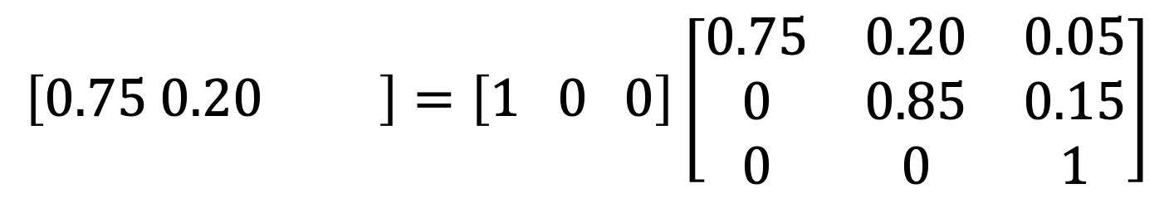
Cohort at next cycle using matrix multiplication
Cohort distribution at next time step calculated through matrix multiplication
$$\left[0.75 0.20 0.05\right]=\left[1 0 0\right]\left[\begin{matrix}0.75 & 0.20 & 0.05 \\ 0 & 0.85 & 0.15 \\ 0 & 0 & 1\end{matrix}\right]$$
$$\text{P}\text{(}\text{S} \text{at} t=1\text{)=(1)(0.20)+(0)(0}\text{.85}\text{)+(0)(0) = 0.20}$$
Notes:
4

Slide 43
Cohort at next cycle using matrix multiplication
Cohort distribution at next time step calculated through matrix multiplication
$$\left[0.75 0.20 0.05\right]=\left[1 0 0\right]\left[\begin{matrix}0.75 & 0.20 & 0.05 \\ 0 & 0.85 & 0.15 \\ 0 & 0 & 1\end{matrix}\right]$$
Notes:
4

Slide 44
Cohort at next cycle using matrix multiplication
Cohort distribution at next time step calculated through matrix multiplication
$$\left[0.75 0.20 0.05\right]=\left[1 0 0\right]\left[\begin{matrix}0.75 & 0.20 & 0.05 \\ 0 & 0.85 & 0.15 \\ 0 & 0 & 1\end{matrix}\right]$$
$$\text{P}\text{(}\text{D} \text{at} t=1\text{)=(1)(0.05)+(0)(0.15)+(0)(1) = 0.05}$$
Notes:
4

Slide 45
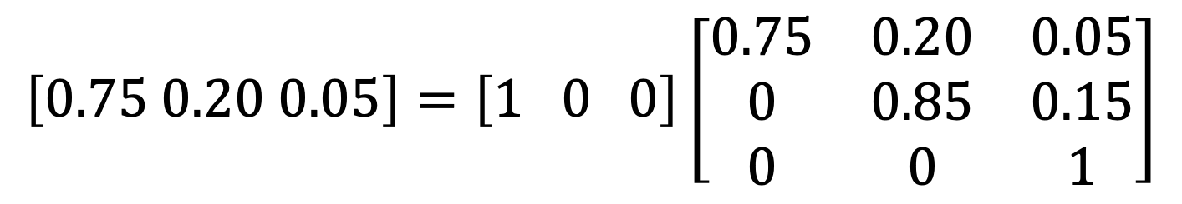
Cohort at next cycle using matrix multiplication
Cohort distribution at next time step calculated through matrix multiplication
$$\left[0.75 0.20 0.05\right]=\left[1 0 0\right]\left[\begin{matrix}0.75 & 0.20 & 0.05 \\ 0 & 0.85 & 0.15 \\ 0 & 0 & 1\end{matrix}\right]$$
$$\text{P}\text{(}\text{D} \text{at} t=1\text{)=(1)(0.05)+(0)(0.15)+(0)(1) = 0.05}$$
Notes:
4

Slide 46
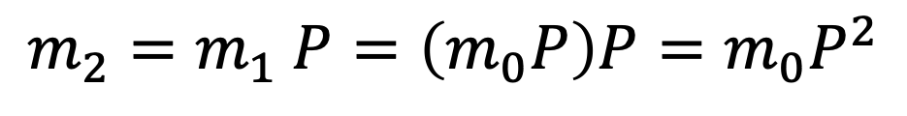
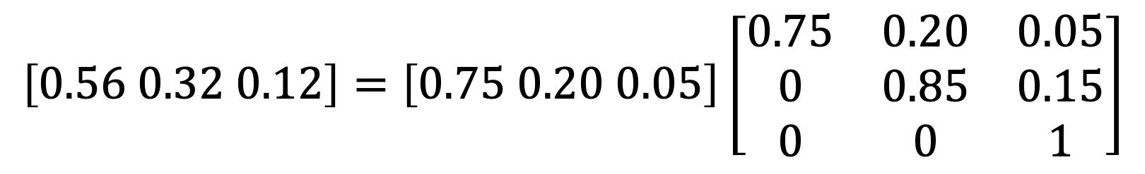
Two-cycle state vector
$$\text{P}\text{(}\text{H} \text{at} t=\text{2)=(0.75)(0.75)+(0.20)(0)+(0.05)(0) = 0.56}$$
$$\text{P}\text{(}\text{S} \text{at} t=\text{2)=(0.75)(0.20)+(0.20)(0}\text{.85}\text{)+(0.05)(0) = 0.32}$$
$$\text{P}\text{(}\text{D} \text{at} t=\text{2)=(0.75)(0.05)+(0.20)(0.15)+(0.05)(1) = 0.05}$$
$$\left[0.56 0.32 0.12\right]=\left[0.75 0.20 0.05\right]\left[\begin{matrix}0.75 & 0.20 & 0.05 \\ 0 & 0.85 & 0.15 \\ 0 & 0 & 1\end{matrix}\right]$$
$$m_{2}=m_{1} P=\left(m_{0}P\right)P=m_{0}P^{2}$$
Year 2 vector
Matrix squared
Notes:
4

Slide 47

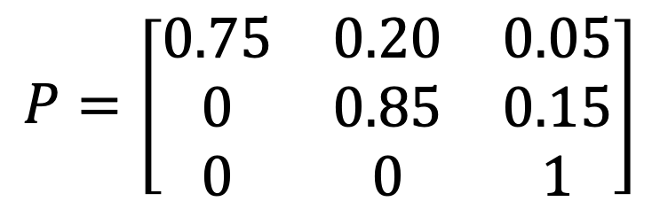

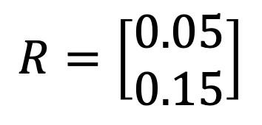
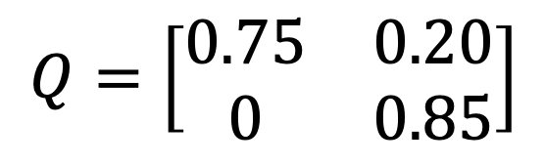
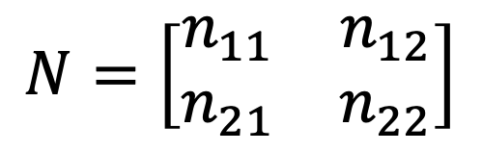
Estimating Mean Residence Times in States from the Transition Matrix
$$P=\left[\begin{matrix}0.75 & 0.20 & 0.05 \\ 0 & 0.85 & 0.15 \\ 0 & 0 & 1\end{matrix}\right]$$
$$Q=\left[\begin{matrix}0.75 & 0.20 \\ 0 & 0.85\end{matrix}\right]$$
$$R=\left[\begin{matrix}0.05 \\ 0.15\end{matrix}\right]$$
$$I=\left[1\right]$$
$I=$ Identity matrix (1’s in right diagonal, 0 otherwise)
Let $n_{ij}=$ expected residence time in state $j$, given start in state $i$ at time 0 and define $N$ as
$$N=\left[\begin{matrix}n_{11} & n_{12} \\ n_{21} & n_{22}\end{matrix}\right]$$
Key model result
Notes:
4

Slide 48
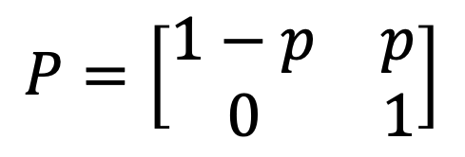
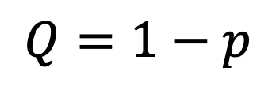
Simple example
$$P=\left[\begin{matrix}1−p & p \\ 0 & 1\end{matrix}\right]$$
$$Q=1−p$$
Given an initial state of alive, what is the expected duration in that state?
Notes:
4

Slide 49
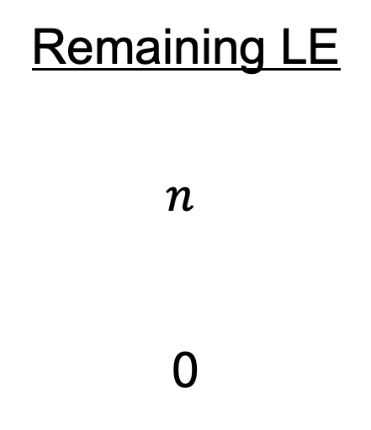
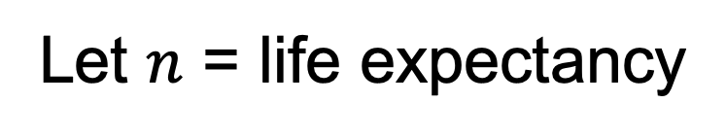
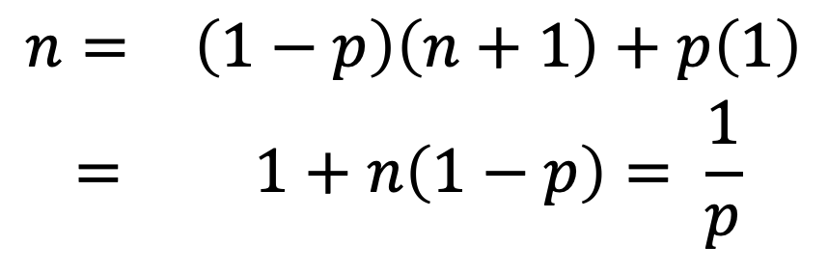

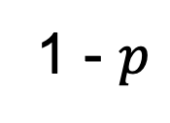
Let $n$ = life expectancy
Remaining LE
$$n$$
0
1 - $p$
Alive
Alive
$$p$$
Dead
The fundamental equation is:
$$\begin{matrix}n= & \left(1−p\right)\left(n+1\right)+p\left(1\right) \\ = & 1+n\left(1−p\right)= \frac{1}{p}\end{matrix}$$

Slide 50
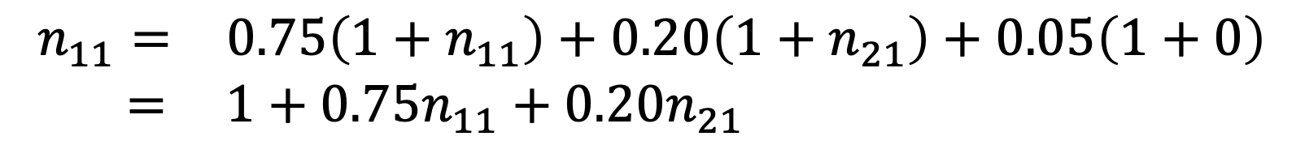
E(Healthy)
n₁₁
n₂₁
0
E(Sick)
n₁₂
n₂₂
0
Healthy
0.75
Start
Healthy
Sick
0.20
Dead
0.05
$$\begin{matrix}n_{11}= & 0.75\left(1+n_{11}\right)+0.20\left(1+n_{21}\right)+0.05\left(1+0\right) \\ = & 1+0.75n_{11}+0.20n_{21} \end{matrix}$$
$$n_{12}=0.75n_{12}+0.20n_{22}+0.05\left(0\right)$$

Slide 51
E(Healthy)
n₁₁
n₂₁
0
E(Sick)
n₁₂
n₂₂
0
Healthy
0.4
Start
Sick
Sick
0.2
Dead
0.4

Slide 52
Solve for n₁₁ and n₂₁ using two equations from previous slides:

Slide 53
Solve for n₁₂ and n₂₂ using two equations from previous slides:

Slide 54
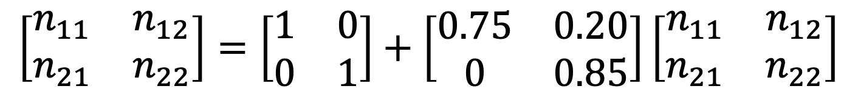
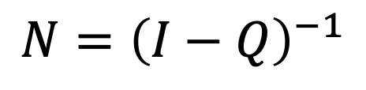
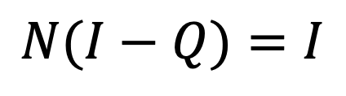
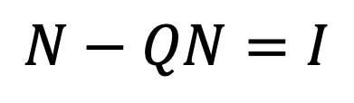
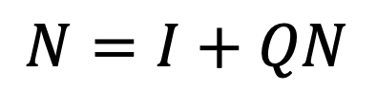
Closed-Form Solution
$$\left[\begin{matrix}n_{11} & n_{12} \\ n_{21} & n_{22}\end{matrix}\right]=\left[\begin{matrix}1 & 0 \\ 0 & 1\end{matrix}\right]+\left[\begin{matrix}0.75 & 0.20 \\ 0 & 0.85\end{matrix}\right]\left[\begin{matrix}n_{11} & n_{12} \\ n_{21} & n_{22}\end{matrix}\right]$$
$$N=I+QN$$
$$N−QN=I$$
$$N(I−Q)=I$$
$$N={\left(I−Q\right)}^{−1}$$
Fundamental matrix solution
Notes:
4

Slide 55
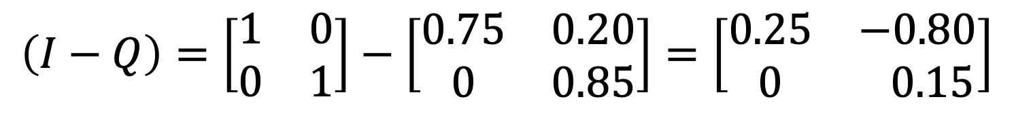
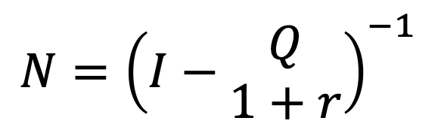
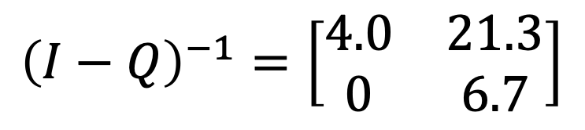
In the example…
$$\left(I−Q\right)=\left[\begin{matrix}1 & 0 \\ 0 & 1\end{matrix}\right]−\left[\begin{matrix}0.75 & 0.20 \\ 0 & 0.85\end{matrix}\right]=\left[\begin{matrix}0.25 & −0.80 \\ 0 & 0.15\end{matrix}\right]$$
$${\left(I−Q\right)}^{−1}=\left[\begin{matrix}4.0 & 21.3 \\ 0 & 6.7\end{matrix}\right]$$
LE = 25.3 (start Healthy)
LE = 6.70 (start Sick)
With discounting:
$$N={\left(I−\begin{matrix}Q \\ 1+r\end{matrix}\right)}^{−1}$$
Notes:
4

Slide 56
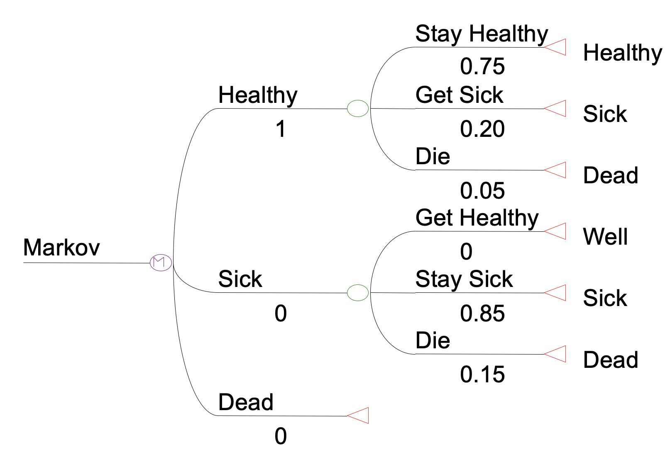
Matrix Form in a Tree Form
Notes:
4

Slide 57
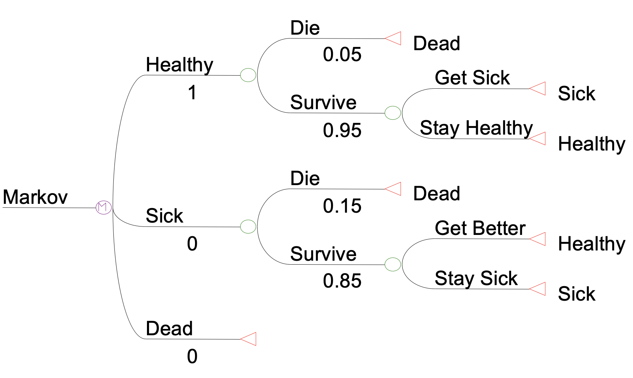
A more common structure…
Notes:
4

Slide 58
Markov Cycle Trees
Markov models can be “grafted” onto decision trees at terminal nodes (i.e., Markov nodes)
The averaged-out value at a Markov node is the desired summary value of the Markov process (e.g., QALE)
Notes:
4

Slide 59
CEA of Test 1
Costs QALYs
Disease Y
20,000 9.0
Treat All
0.01
No Disease Y
20,000 9.9
0.99
Disease Y
Test +/Treat
20,020 9.0
0.1538
0.0508
No Disease Y
Test 1
20,020 9.0
Disease Y
Test -/ No treat
20 8.0
0.0011
0.9415
No Disease Y
20 10.0
Disease Y
0 8.0
Treat None
0.01
No Disease Y
0 10.0
0.99

Slide 60
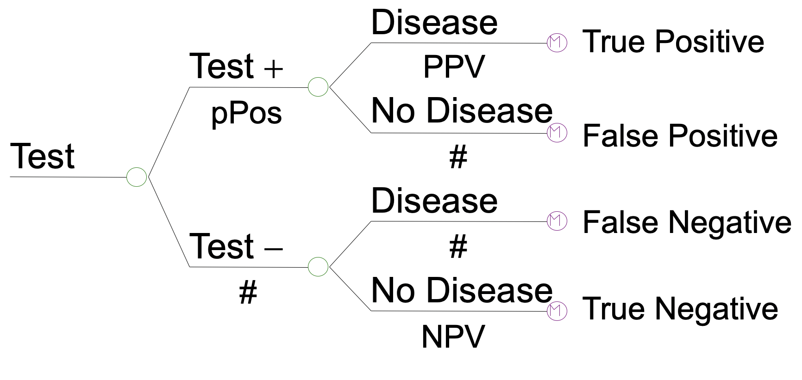
Typical Diagnostic Test Strategy
Notes:
4

Slide 61
Markov Cohort Method
Provides Markov trace (which shows the distribution of the population in each cycle)
Gives an approximation to residence times
Allows for half-cycle correction
Calculates average number of cycles in each state (can weight cycles by utility or discount factor)
Notes:
4

Slide 62
Life Expectancy
1.0
1.0
0.0
WELL
SICK
DEAD
Notes:
4

Slide 63
Discounted Life Expectancy
(r = discount rate, t = _stage)
0.0
WELL
SICK
DEAD
Notes:
4

Slide 64
Model Outcome ?
0.0
1.0
0.0
WELL
SICK
DEAD
Notes:
4

Slide 65
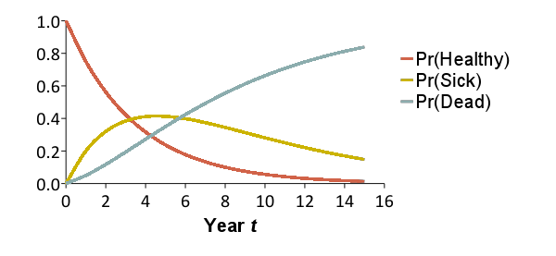
Markov cohort trace
Reflects the distribution of a cohort of patients over a set of states over time
x₀ = [1.00 0.00 0.00]
x₁ = [0.75 0.20 0.05]
x₂ = [0.56 0.32 0.12]
x₃ = [0.42 0.38 0.19]
x₄ = [0.32 0.41 0.27]
x₅ = [0.24 0.41 0.35]
x₁₀ = [0.06 0.28 0.66]
0.20
0.15
0.75
Healthy
Sick
Dead
0.85
1.0
0.05
x_{t}(1)
Proportion
x_{t}(2)
x_{t}(3)

Slide 66
Markov cohort trace
Reflects the distribution of a cohort of patients over a set of states over time
x₀ = [1.00 0.00 0.00]
x₁ = [0.75 0.20 0.05]
x₂ = [0.56 0.32 0.12]
x₃ = [0.42 0.38 0.19]
x₄ = [0.32 0.41 0.27]
x₅ = [0.24 0.41 0.35]
x₁₀ = [0.06 0.28 0.66]
x₁₅ = [0.01 0.15 0.84]
0.20
0.15
0.75
Healthy
Sick
Dead
0.85
1.0
0.05
x_{t}(1)
Proportion
x_{t}(2)
x_{t}(3)

Slide 67
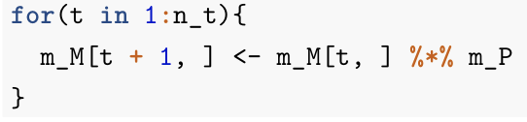
Markov cohort trace
In R, let’s define the cohort trace as m_M and the transition matrix as m_P
To compute the trace, iterate the matrix multiplication between the state vector at time t and the transition matrix

Slide 68
Markov Trace (Life-Years)
Calculate expected remaining LE, QALE, costs
  Multiply cohort distribution by state-specific values to calculate expected value at each time
  Sum expected values over time (discount if desired)
Life-Years:
1.0
1.0
0.0
Time | Healthy | Sick | Dead | E[LYs]
0 | 1.0 | 0.0 | 0.0 | --
1 | 0.75 | 0.20 | 0.05 | 0.95
2 | 0.56 | 0.32 | 0.12 | 0.88
3 | 0.42 | 0.38 | 0.19 | 0.81
 | … | … | …
Sum
* 1/(1+r)
* 1/(1+r)²
* 1/(1+r)³
Total life years: 6.77 years
(Remaining life expectancy)

Slide 69
Markov Trace (Costs)
Calculate expected remaining LE, QALE, costs
  Multiply cohort distribution by state-specific values to calculate expected value at each time
  Sum expected values over time (discount if desired)
Costs:
$500
$2,500
$0
Time | Healthy | Sick | Dead | E[Costs]
0 | 1.0 | 0.0 | 0.0 | --
1 | 0.75 | 0.20 | 0.05 | $875
2 | 0.56 | 0.32 | 0.12 | $1,081
3 | 0.42 | 0.38 | 0.19 | $1,1,72
 | … | … | …
Sum
* 1/(1+r)
* 1/(1+r)²
* 1/(1+r)³
Total costs: $11,557
(Total remaining lifetime costs)

Slide 70
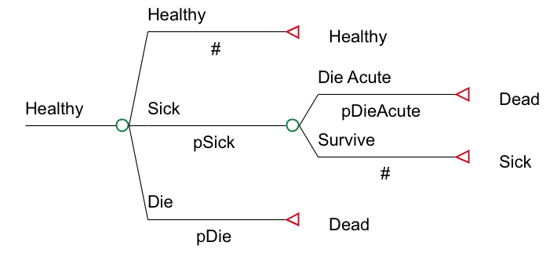
Transition Probabilities
Pr(Healthy → Dead) may not be conceptualized as one number
p_HD = p_Die + p_Sick * p_DieAcute

Slide 71
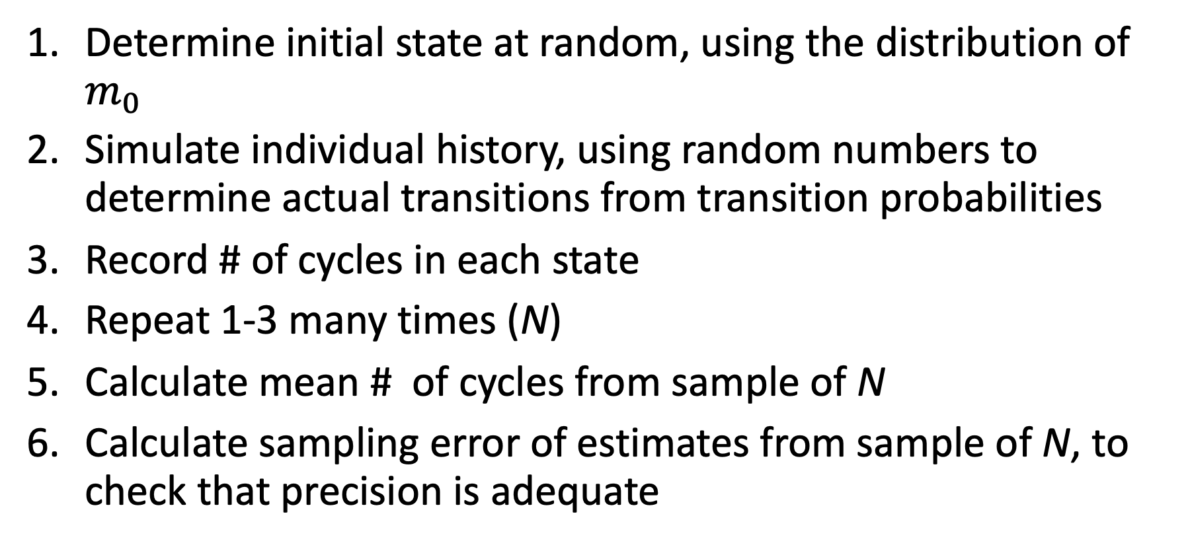
Monte Carlo Simulation
Determine initial state at random, using the distribution of $m_{0}$
Simulate individual history, using random numbers to determine actual transitions from transition probabilities
Record # of cycles in each state
Repeat 1-3 many times (N)
Calculate mean # of cycles from sample of N
Calculate sampling error of estimates from sample of N, to check that precision is adequate
Notes:
4

Slide 72
Monte Carlo Simulation
Healthy
Sick
Dead
Healthy
Sick
Dead
Healthy
Sick
Dead
HHSD
Sick
Dead
Healthy

Slide 73
Comparison of Methods
Cohort Method
  short computing time
  no sampling error in estimates
  relatively easy to debug (with trace)
  models can get large
Monte Carlo Simulation
  works well if there are a large # of variables
  takes considerable computing time
  potential for sampling error
  more trouble debugging
Notes:
4

Slide 74
Benefits of Markov Models
Extrapolate benefits and costs beyond time horizon of existing data
Consider all relevant policy strategies
Incorporate data from multiple sources
Evaluates “what if” scenarios
Notes:
4

Slide 75
Extend Beyond Time Horizon
Can “translate” an intermediate endpoint (e.g., increase in CD4 count, decrease of employment) into policy endpoints such as life years saved, quality-adjusted life years gained or economic returns
Incorporates important long-term effects of policies
Notes:
4

Slide 76
Data from Multiple Sources
Data from primary sources
Existing databases
Studies reported in the literature
Expert opinion
Notes:
4

Slide 77
“What If” Scenarios
How great would the increase in school attendance of a conditional cash transfer (CCT) program has to be to justify its implementation at a national level?
How effective does a policy need to be, and at what duration of treatment effect, to replace current practices?
Identifies important gaps in our knowledge
Notes:
4

Slide 78
Typical Problems in Markov Modeling
Population heterogeneity (e.g., risk factors)
  decompose states
Transition probabilities depend on prior history
  expand state descriptions to reflect prior states
  special case (tunnel states): transition probabilities depend on duration in current state
Notes:
4

Slide 79
Regular (Non-Absorbing) Markov Chains
→ No absorbing state

Slide 80
Example (Stokey & Zeckhauser)
Sick Sick
Well 1st day 2+ days
Cycle length = 1 day
Interested in long-run behavior

Slide 81
If p* is equilibrium, then
two independent equations

Slide 82
Solve 3 equations, 3 unknowns
Note: The long-run distribution is p*, no matter where you start!

Slide 83
R session

Slide 84
Time-dependent

Slide 85
Time-dependency
Since start of the simulation
Transition probabilities often depend on age
  Background mortality
  Risk of developing disease or experiencing an event
Depending on state residency
Some transition probabilities depend on time since an event, not age
  e.g., The risk of developing recurrence among newly diagnosed cancer patients declines with time
Notes:
4

Slide 86
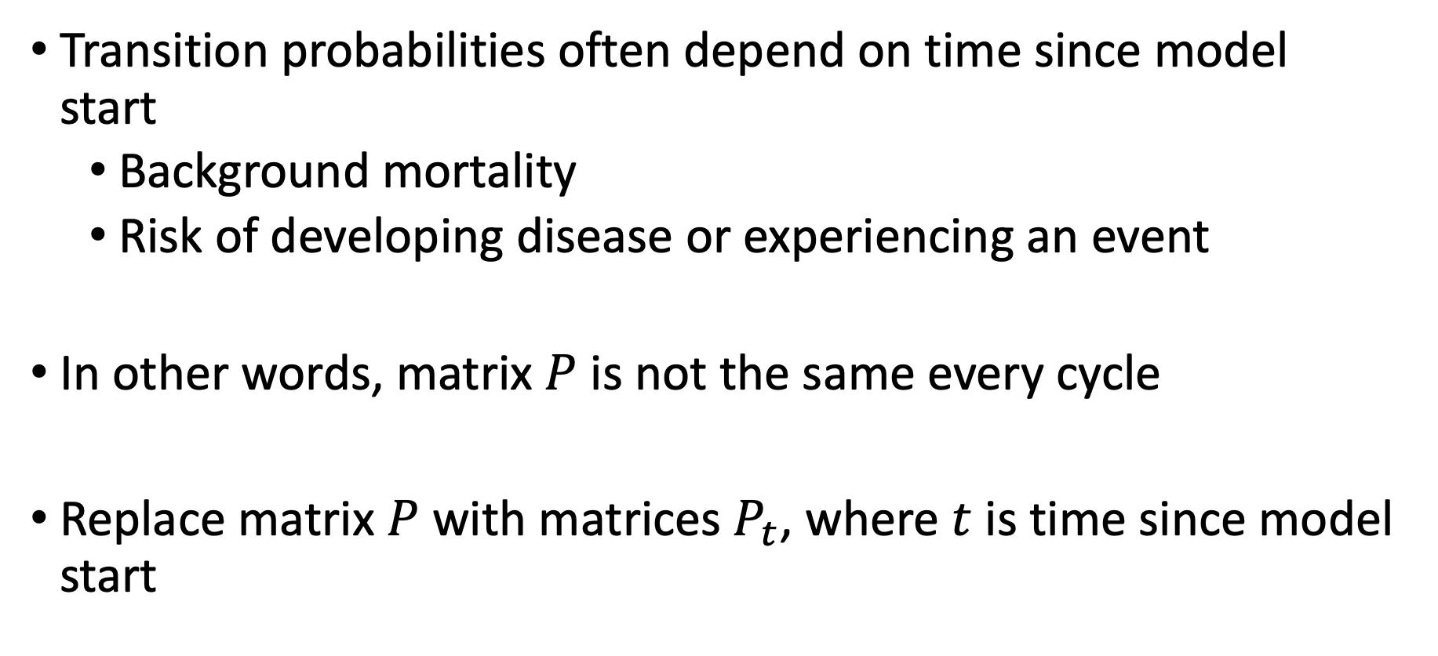
Time-dependency since simulation start
Transition probabilities often depend on time since model start
  Background mortality
  Risk of developing disease or experiencing an event
In other words, matrix $P$ is not the same every cycle
Replace matrix $P$ with matrices $P_{t}$, where $t$ is time since model start
Notes:
4

Slide 87
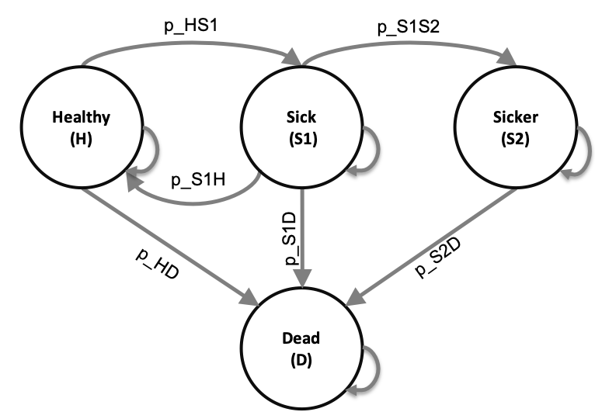
The Sick-Sicker model
Four health states
All individuals start in the Healthy state
Notes:
4

Slide 88
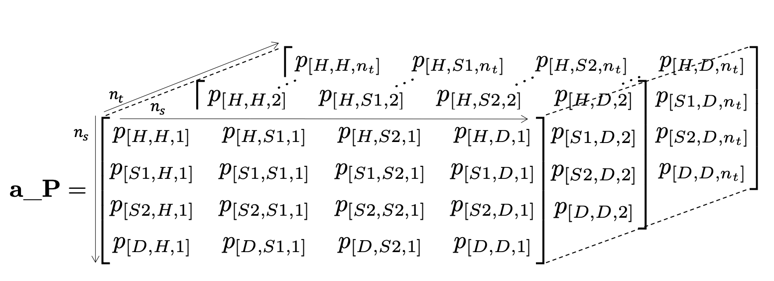

Time-dependency since simulation start
We create a 3D array, a_P, that stores a collection of time-varying transition matrices, $P_{t}$, in the third dimension
For the Sick-Sicker Markov model:
Notes:
4

Slide 89
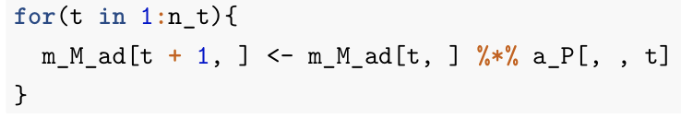
Time-dependency since simulation start
Iterate over the third dimension of a_P

Slide 90
Time-dependency based on state-residence
“Memoryless” property of Markov models is a BIG assumption
  Transition probabilities only depend on the current state and not on past states
Many transition probabilities depend on model history, not time since model start
  Risk of myocardial infarction (MI) greater for persons with prior MI
Notes:
4

Slide 91


Tunnel states
If transition probabilities do not depend on the time since model start, replacing $P$ with $P_{t}$does not work
  E.g., Cohort of healthy patients at risk for cancer, but once cancer is diagnosed the risk of recurrence depends on time since diagnosis
Solution?
  Create “tunnel” states
Notes:
4

Slide 92
Model with double time dependency
f(model time)
f(state time)
Healthy
Sick
Sicker
Dead
Tunnel state
Notes:
4

Slide 93


Tunnel states
p_S1S2₁
Sick 1
p_S1S2₂
Sick 2
p_S1S2₃
Sick 3
Sicker
p_S1S2₄
Sick 4
p_S1S2$τ$
Sick $τ$
Transitions to Dead also allowed.

Slide 94

Time-dependent probabilities
Progression from Sick to Sicker increases the longer a person has been sick
This increase follows a Weibull hazard:
$$p_{S1S2}\left(τ\right)=λγτ^{(γ−1)}$$
$τ$ represents the time since getting Sick
Notes:
4

Slide 95

Time-dependent probabilities
Expand the states of the 3D array by the number of cycles considered in the time-dependency variable(s)
For the Sick-Sicker Markov model:
Notes:
4

Slide 96

Time-dependent probabilities
Expand the states of the 3D array by the number of cycles considered in the time-dependency variable(s)
The transition array for the Sick-Sicker Markov model:
Notes:
4

Slide 97
R session

